Slide 1
Course - DT228-2
Module (Subject) -
Human Computer Interaction
Semester 2, Week 11
USABILITY (and EVALUATION)

Slide 2
Usability - Guidelines, Principles Usability - Evaluation
Lecture 11

Slide 3
Overview of Lecture
Introduce “Usability”
Guidelines
Principles
Introduce “Evaluation”
Evaluation methods
Acceptance testing

Slide 4
What is Usability?
Satisfaction
Learnability
Errors
Usability
Efficiency
Memorability

Slide 5
What is Usability? (2)
Usability can be defined as:
“The capacity to be used by humans easily and effectively where,
easily = to a specified level of subjective assessment
effectively = to a specified level of human performance” (Shackel, 1990)
Usability affords the user easy access to the product’s functions.

Slide 6
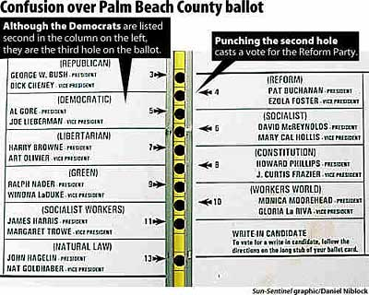
Bad Usability with major consequences…

Slide 7
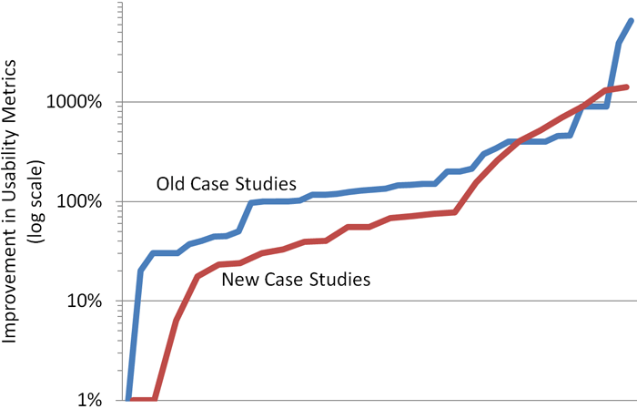
A Measure of Usability
This chart compares the results distribution from both editions of a Usability Return on Investment report. The different case studies are arranged across the horizontal axis (sorted by increasing metric improvements). The vertical axis shows each case study's recorded improvement.
http://www.useit.com/alertbox/roi.html It is possible to measure usability in case studies
Usability Issues

Slide 8
Usability
Guidelines are a basis for determining a course of action
Principles are basic rules that guide or influence thoughts or actions
Theories (in this context) are general principles that explain or predict facts or events

Slide 9
Usability (2)
Guidelines
Principles
Theories

Slide 10
Usability (3)
Guidelines
Principles
Theories

Slide 11
Guidelines
With guidelines, an interface designer can:
develop a shared language
Promote consistency in design
Record best practices (for reporting)

Slide 12
Android Development User Interface Guidelines
EG - Use a wide variety of icons
Technical specs, with templates provided.
Icon design
Widget design
Activity & Task design
Menu design
Describes how widgets fit together with graphics templates.
Describes navigation, multitasking, activity re-use, intents, and the activity stack.
Describes how to arrange menu items, when to put commands on-screen, and other details about menu design.
Guidelines

Slide 13
Web Content Accessibility Guidelines
Web development:
Web Content has accessibility guidelines (WCAG)

Slide 14
Some WCAG Guidelines
Provide a text equivalent for every non-text (EG graphic) element
Ensure that information does not rely on colour perception
Avoid causing the screen to flicker
Provide an auditory description of the visual information in multimedia presentations
For multimedia, ensure that timing of alternative descriptions is synchronised with the presentation
Use the clearest and simplest language appropriate

Slide 15
exercise 1
By drawing on only your experience and common sense, consider four guidelines that would be applicable to the design of a screen for data entry.

Slide 16
Facilitating data Entry
Smith and Mosier (1986) offer five high-level objectives as part of their guidelines for data entry:
Consistency of data-entry transactions
Minimal input actions by user
Minimal memory load on users
Compatibility of data entry with data display
Flexibility for user control of data entry

Slide 17
Usability (4)
Guidelines
Principles
Theories

Slide 18
Principles
Generally, principles:
are more fundamental, widely applicable, and enduring than guidelines
are largely independent of technology
often need more clarification
Principles

Slide 19
exercise 2
Which of the following are principles:
Always issue a warning message to the user before deleting a file
Provide a ‘RESET’ command
Design for user growth
Allow input flexibility
Adapt to user levels and styles
Ensure ease of understanding
Display the ‘quit’ button in the bottom left-hand corner of the screen

Slide 20
exercise 2 (answered)
Which of the following are principles:
Always issue a warning message to the user before deleting a file
Provide a ‘RESET’ command
Design for user growth
Allow input flexibility
Adapt to user levels and styles
Ensure ease of understanding
Display the ‘quit’ button in the bottom left-hand corner of the screen

Slide 21
Principles (2)
For any system or product:
Principles of Universal Design – can be applied to any system or product used by people
For computer systems:
Nielsen’s Usability Principles - used mostly as the basis for evaluating prototypes and existing systems
` Many principles of both are overlapping
Principles

Slide 22
Universal design Case Study
The 24-Hour Universal Design Challenge
Principles

Slide 23
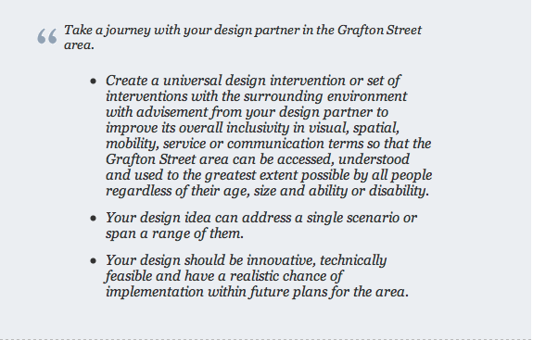
The 24-Hour Universal Design Challenge

Slide 24
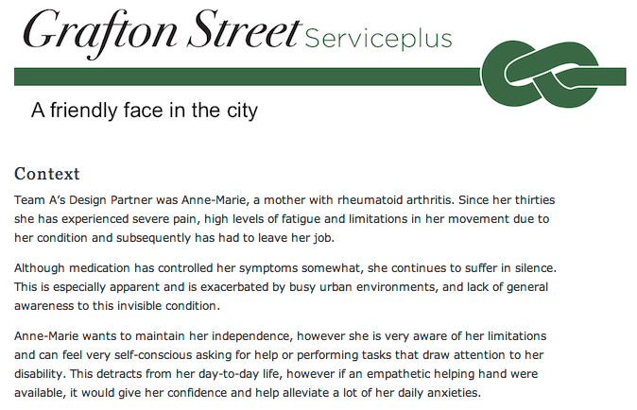
The 24-Hour Universal Design Challenge (2)

Slide 25
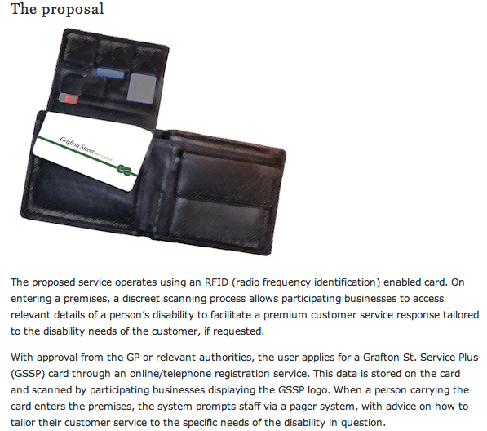
The 24-Hour Universal Design Challenge (3)

Slide 26
Evaluation
Two types of evaluation:
Formative evaluation is done at different stages of development to check that the product meets users’ needs.
Summative evaluation assesses the quality of a finished product.
Our focus is on formative evaluation
Evaluation Issues

Slide 27
Evaluation (2)
What to evaluate:
Iterative design and evaluation is a continuous process that examines:
Early ideas for conceptual model
Early prototypes of the new system
Later, more complete prototypes
Designers need to check that they understand users’ requirements.
Evaluation Issues

Slide 28
Evaluation (3)
When to evaluate:
Throughout design
From the first descriptions, sketches etc., of users needs through to the final product
Design proceeds through iterative cycles of ‘Design-Test-Redesign’
Evaluation is a key ingredient for a successful design
Evaluation Issues

Slide 29
Evaluation (4)
Evaluation paradigms
Expert reviews
Usability testing
Survey instruments
Acceptance testing
Evaluation Issues

Slide 30
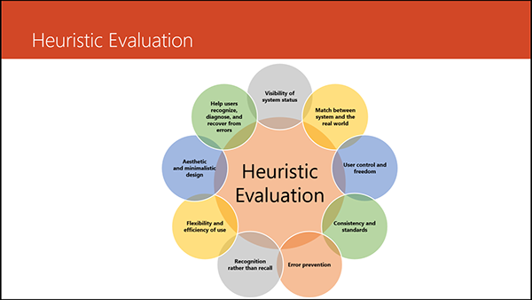
EVALUation (5)
Evaluation Issues

Slide 31
Expert Reviews
Formal expert reviews have proven to be effective.
Expert review methods:
Heuristic evaluation
Guidelines review
Consistency inspection
Cognitive walkthrough
Formal usability inspection
Evaluation Issues

Slide 32
Design Evaluation
Interface Design Evaluation Approach
Evaluate Conceptual Design
Steps in Design
Theoretical Foundation
Conceptual Design of Instruct. Strategies
Usability 
Ease of Use, Ease of Learning
User Acceptance
Learning Outcome
Effectiveness

Slide 33
Design Evaluation (2)
User-centred evaluation approach
Evaluation for testing prototypes, using:
Expert Evaluation
Heuristics and walk-throughs
Predictive evaluation
Testing against an engineering model (EG Simulated User)
Empirical evaluation
Watching users use the product

Slide 34
Usability Testing
Usability testing involves measuring typical users’ performance on tasks that are typical of those for which the system was designed
Performance is generally measured in terms of number of errors and time to complete the task
Evaluation Issues

Slide 35
Usability Testing (2)
Forms of usability testing:
Paper mockups
Discount usability testing
Competitive usability testing
Universal usability testing
Field test and portable labs
Remote usability testing
‘Can-you-break-this?’ tests
Evaluation Issues

Slide 36
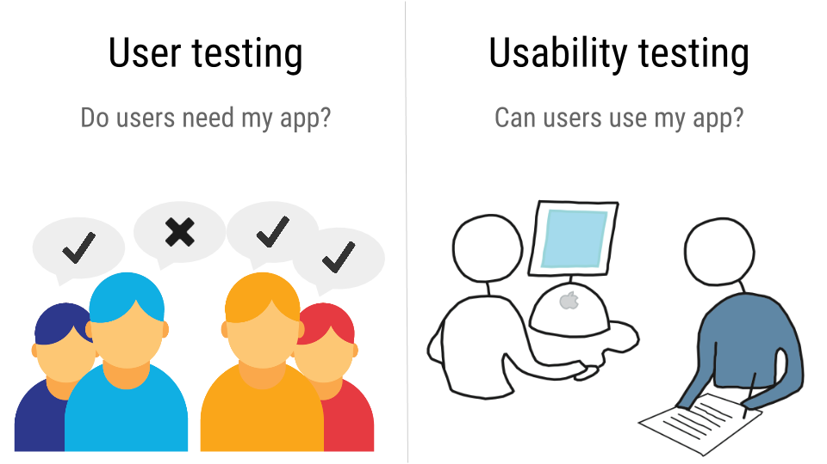
Usability Testing (3)
Evaluation Issues

Slide 37
Survey Instruments
Written user surveys are a familiar, inexpensive companion for usability tests and expert reviews.
Keys to successful surveys:
Clear goals in advance
Development of focused items that help attain the goals.
Online surveys avoid the cost of printing and the extra effort needed for distribution and collection of paper forms.
Evaluation Issues

Slide 38
Survey Instruments (2)
The goals would be to ascertain:
Users background (age, gender, origins, education, income)
Experience with computers (specific applications or software packages, length of time, depth of knowledge)
Job responsibilities (decision-making influence, managerial roles, motivation)
Personality style (introvert vs. extrovert, risk taking vs. risk aversive, early vs. late adopter, systematic vs. opportunistic)
Reasons for not using an interface (inadequate services, too complex, too slow)
Familiarity with features (printing, macros, shortcuts, tutorials)
Their feeling state after using an interface (confused vs. clear, frustrated vs. in-control, bored vs. excited)
Evaluation Issues

Slide 39
Acceptance Tests
For large implementation projects, the customer usually sets objective and measurable goals for hardware and software performance - e.g.
Time to learn specific functions
Speed of task performance
Rate of errors by users
Human retention of commands over time
Subjective user satisfaction
If the completed product fails to meet these acceptance criteria, the system must be reworked until success is demonstrated.
Evaluation Issues

Slide 40
Summary of the Lecture
Usability can be defined as the capacity to be used by humans easily and effectively
Ease-of-use
Friendliness
Guidelines - provided a number of sample guidelines
Principles - introduced major principles in HCI
Evaluation – including survey instruments and acceptance testing

Slide 41
References
Norman, D. (1990) The Design of Everyday Things
Preece, J. et al. (2002) Interaction Design
Shneiderman, B. & Plaisant, C. (2005) Designing the User Interface
Shackel, B. (1990) Human Factors and Usability
Smith, S. & Mosier, J. (2005) Guidelines for Designing User Interface Software
Foley, J. & Van Dam, A. (1995) Computer Graphics: Principles & Practices in C
Card, S. & Newell, A. (1983) The Psychology of Human-Computer Interaction
Karat, C. (1990) Cost-benefit analysis of usability engineering techniques
Miller, R. B. (1971) Human ease of use criteria and their tradeoffs
References

